Slide 1
Project Submission Davidson VERSAILLES
Customer Churn Analysis

Slide 2
Problem
Describe the business problem and define the analytic approach to solving the problem.
What is the business problem?
The Business problem is excessive customer loss
Who are the stakeholders impacted by the problem?
The problem impacted by the Team Marketing an the team of customer.
Why is this problem important to the organization?
This problem is important to organize beacause it generates a huge loss both in terms of customers and financially for the company.

Slide 3
Methodology
For the documentation we used the data provided by the company on 7000 customers, some of whom are churn.The variables chosen are those of the dataset which contains the following columns: Churn our independent variable and others that depend on it such as (ServicePhone,CustomerId,MonthlyCharge,Holding,TotalCharges,Gender,paymentMethod...) in order to make calculations to see some aspect about the current state of the company and its future.
The data analyzed is incomplete because we cannot specify the date that the customers left the company. Compared to the data we have:
Created a dataset that allowed us to
Do a Data Preprocessing
Exploration data analysis
Data manipulation

Slide 4
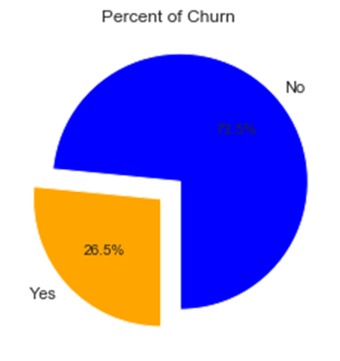
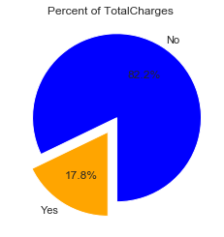
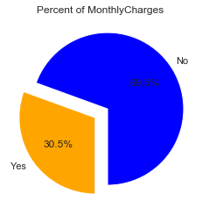
Results
The churn rate is 26.6% for the months prior to the months that affect the company in terms of customer and financial resources since the loyalty of the company as #1 is at stake at such a high churn rate.Compared to existing customers, the churn rate affects women much more than men and also its mass churn could affect the remaining customers from the company but it could affect the quality of existing services.
The amount of churn customers is 26.5% and 73.5% are still our customers
The churn of the customer affect the business cause there's 17.8% of the company's revenue Total is lost
The Churn affect the compagny by a loss of 30.5% per Month.

Slide 5
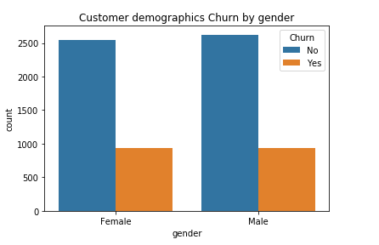
Results
The churn rate is more significant among women than men.

Slide 6
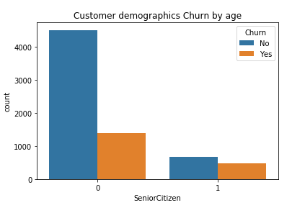
Results
There’s a lot of people who’s not Senior Citizen (age) and who’s churn more.

Slide 7
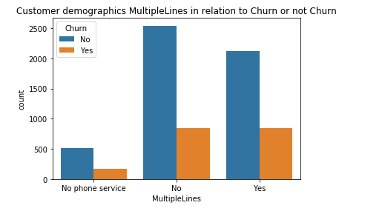
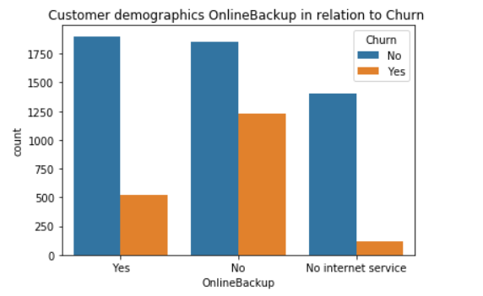
Results
The MultipLines and the BackupOnline is the service that the customers who don’t churn use more in the company that’s why we can use this service to make our customer who don’t churn loyalty.

Slide 8
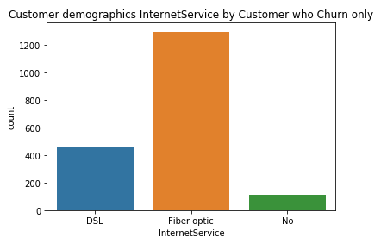
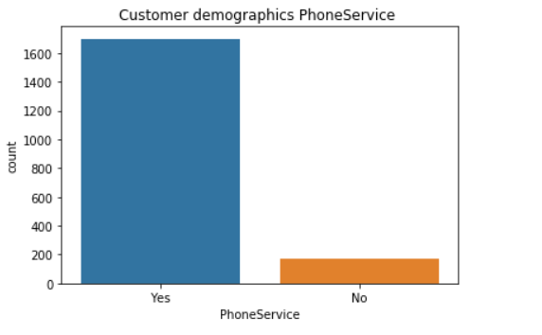
Results
The service more used by the customers who’s churn is the Fiber Internet Optic and the PhoneService

Slide 9
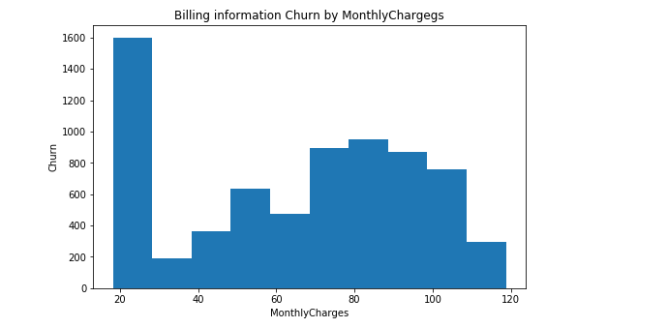
Results
Here we can see the rate that the company lose revenue per month
And we can see the monthly income of the comagny by Churn

Slide 10
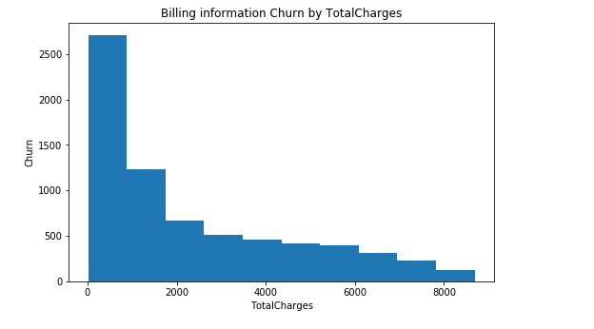
Results
Here there’s the rate the company lose profit in Totales

Slide 11
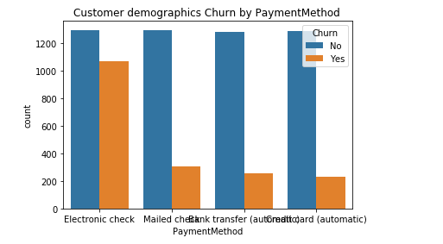
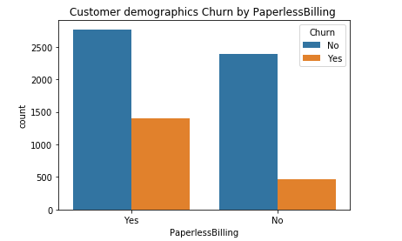
Results
Here all our Billing Information
The way each customer pay these service…
On average, customers with a month-to-month contract, using e-checks as a PaymentMethod and enrolled in PaperlessBilling (Yes) are much more likely to leave (0.576951).
Those with a Two year contract, PaperlessBilling (No), using Mailed check as payment method are the last to leave.

Slide 12
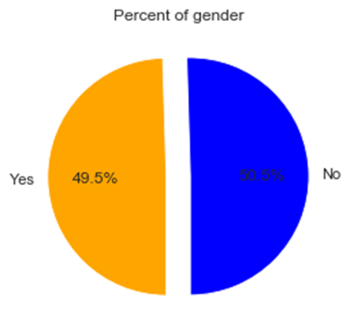
Results
The churn rate is more significant among women than men.

Slide 13
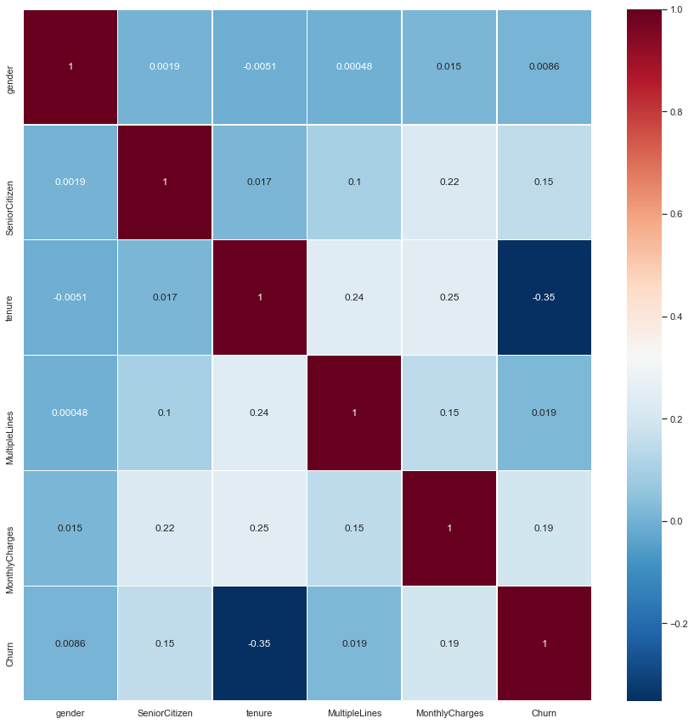
Results
Customers who do not use the internet are more loyal to the company.
Those with a month-to-month contract are more likely to leave. This is followed by Online Security_No, Tech Support_No and fiber optic users at the top.
If the older ones tend to stay, the younger ones are the first to leave.

Slide 14
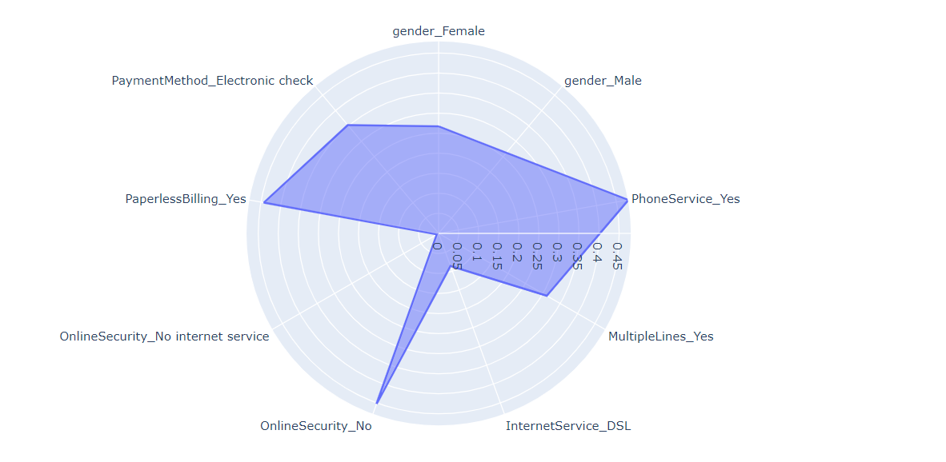
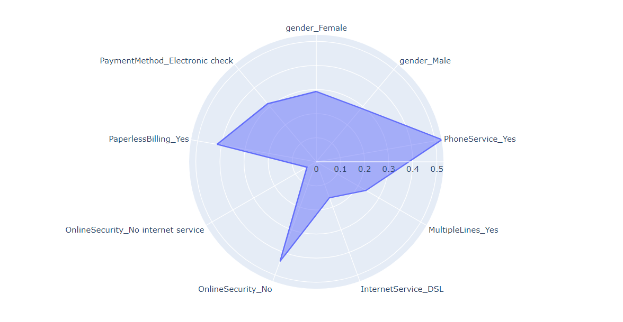
Results
Profile for women major
Profile for women Adult

Slide 15
Discussion & Recommendations
Communicate your recommendations to your audience. Based on your results, how might you propose solving the business problem? (June 15, 2020)
What is your proposed solution?
What are strengths of the organization that you have leveraged in your solution?
What are weaknesses of the organization that could undermine your solution?
What are challenges that you might encounter? How can you mitigate them?

Slide 16
References & Appendices
Provide citations for your work and provide resources for your audience to learn more about the technical aspects of your project. Share links to your GitHub repository or accompanying spreadsheets.

